Slide 1

Data Science and Air Pollution Policy: My Journey
Francesca Dominici, PhD
Clarence James Gamble Professor of Biostatistics, Population and Data Science Harvard T.H. Chan School of Public Health
Co-Director Harvard Data Science Initiative

Slide 2
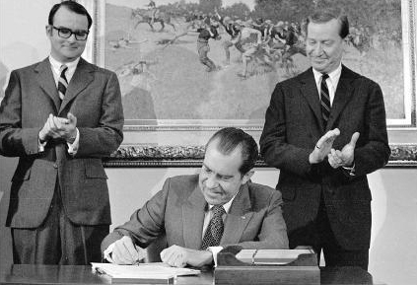
President Nixon signing the Clean Air Act in 1970

Slide 3
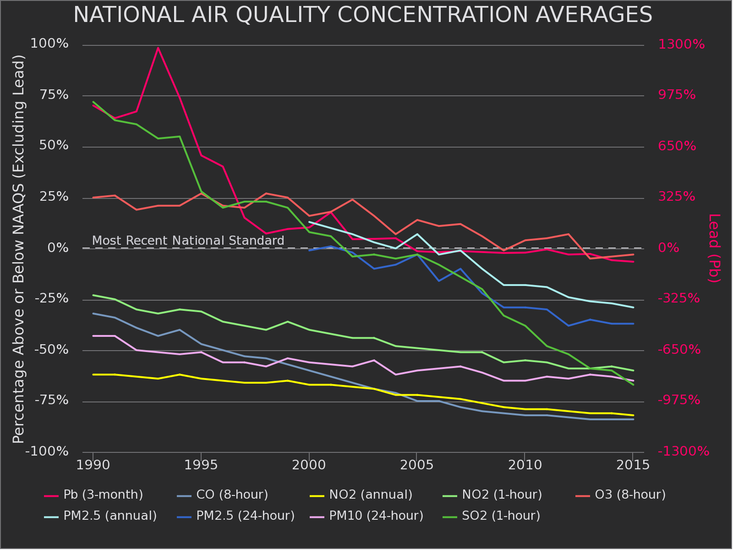

Slide 4

Scientific Questions
1. Is exposure to PM_{2.5} below the NAAQS (35 μg/m³ for daily and 12 μg/m³ for annual) associated with an increase mortality risks?
2. Are some populations at higher risk than others?
Notes:
Francesca – please note that i changed your units here to μg/m³ (from mu_{g}/m³) and also short-term -> daily and long-term -> annual, because the NAAQS are for 24 hr and a year respectively. But when you go over this slide you can say that these correspond to short-term and long-term exposures. Just to be better aligned though with what is regulated. marianthi

Slide 5
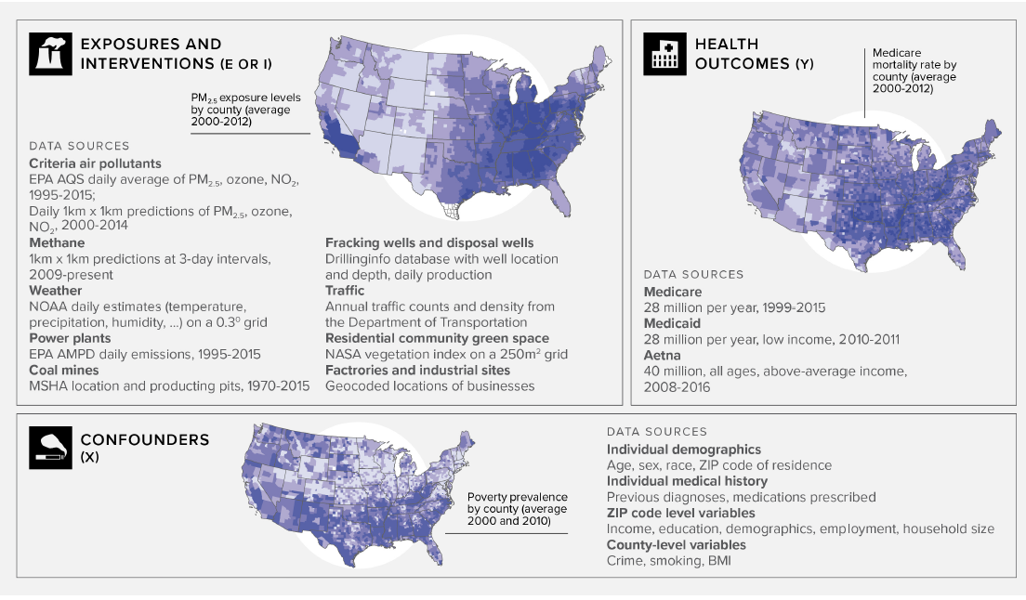
RESEARCH DATA PLATFORM
Notes:
Kevin to add a quote
Give a girl the right shoes (data!), and she can conquer the world. Marilyn Monroe Read more at: https://www.brainyquote.com/authors/marilyn_monroe

Slide 6
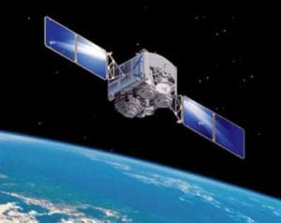
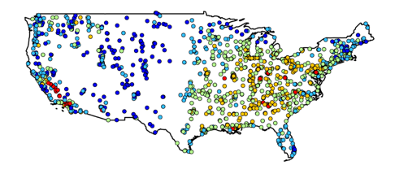
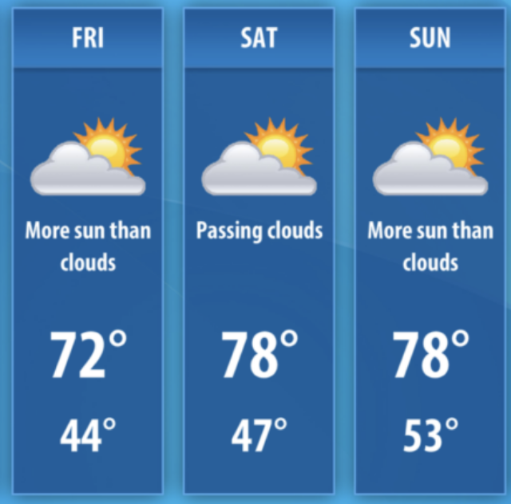
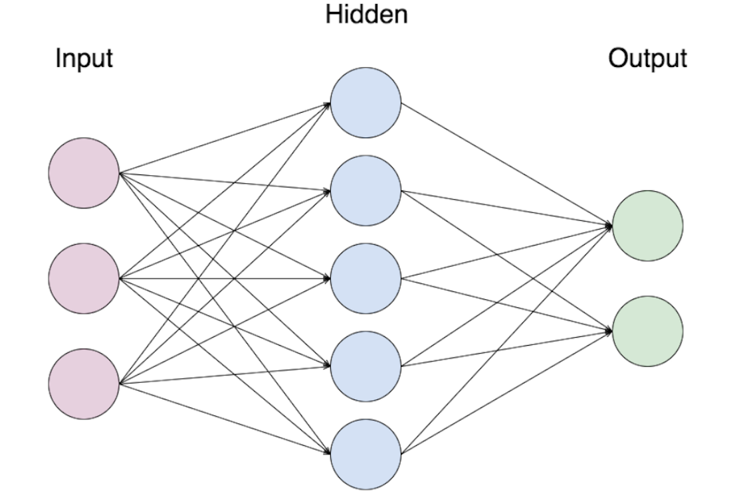
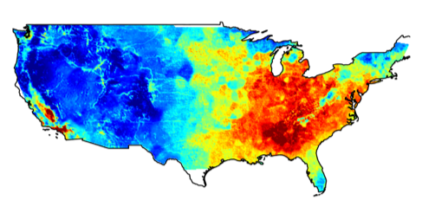

PM_{2.5} Monitor Data
Satellite Imaging
Weather data
Daily 1km x 1km Estimates
Land use data
“To understand how quickly we're cooking the planet, we need good data. To have good data, we need good satellites”
- Jeff Goodell

Slide 7
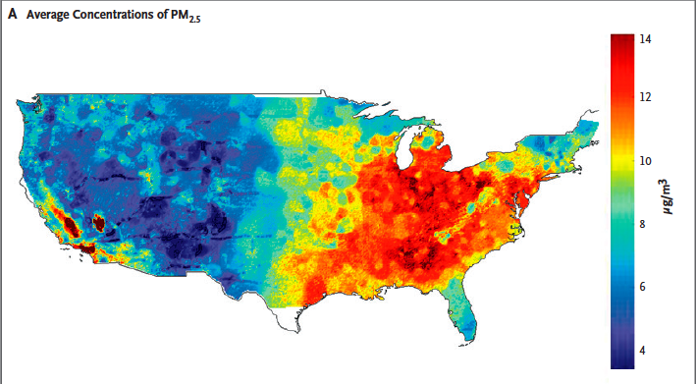

Slide 8
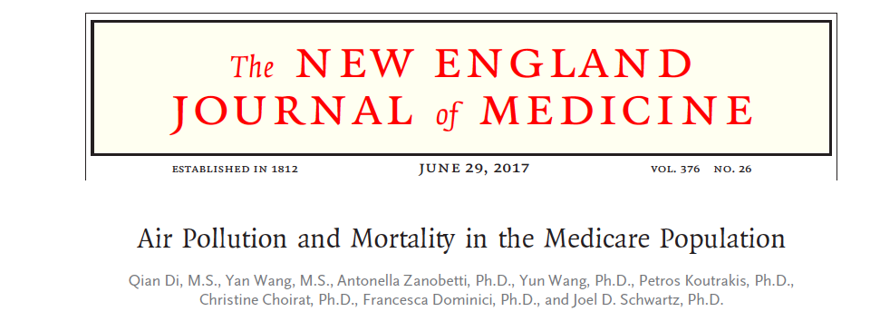

Slide 10
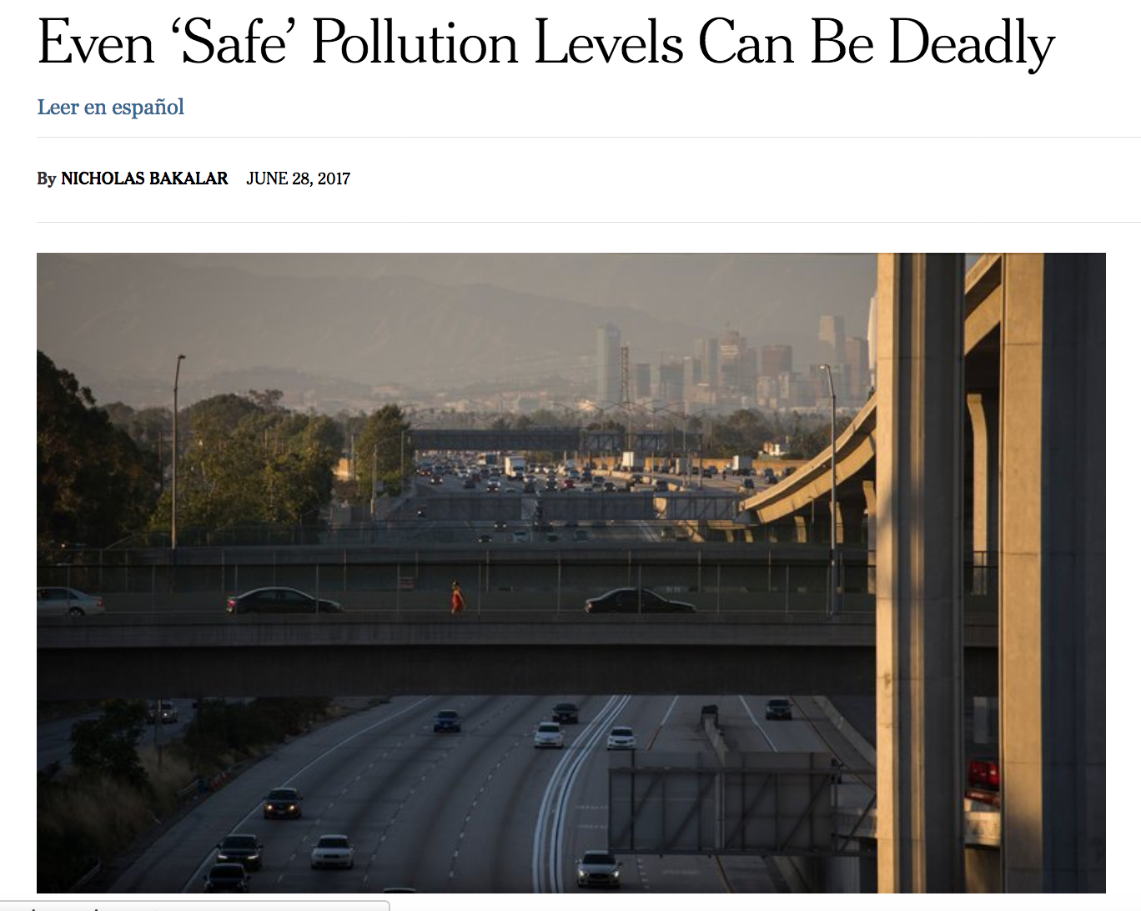
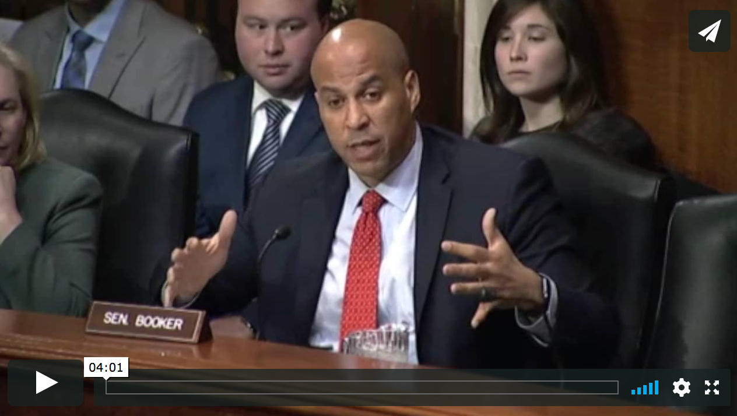
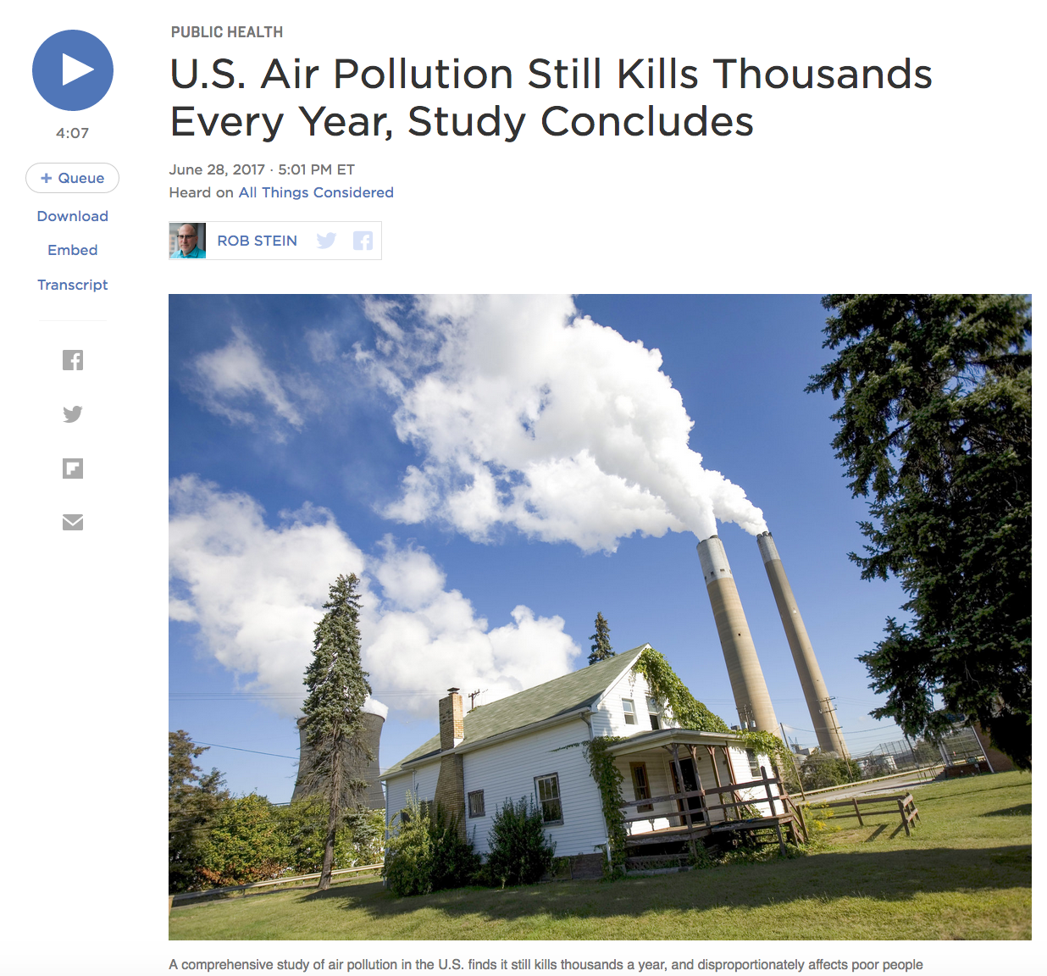
Senator Cory Booker talking about the NEJM study at a hearing on the nominations of Kathleen Hartnett White to be a Member of the Council on Environmental Quality.

Slide 11
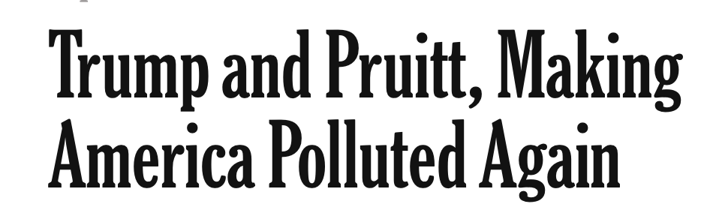
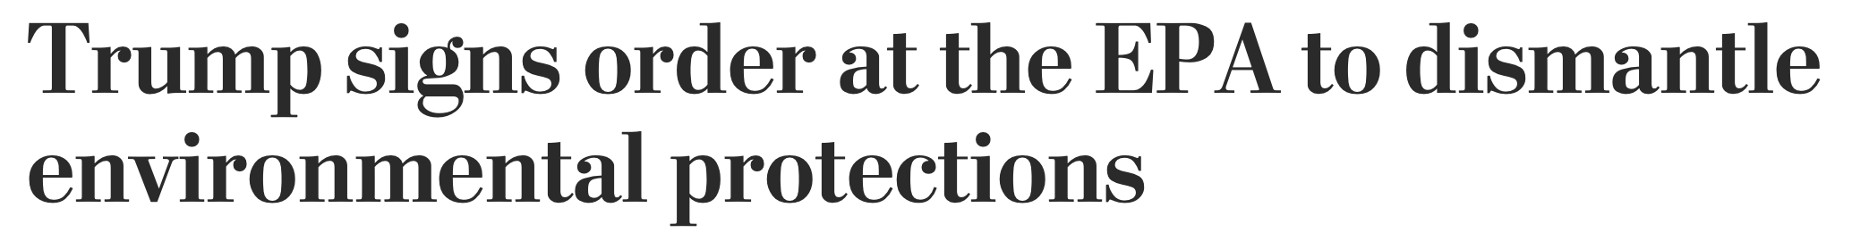

The current political climate
Washington post
The New York Times
Scientific American
Notes:
Kevin: can you please help here, maybe add some headlines since the trump administration and the new EPA?`
https://www.washingtonpost.com/national/health-science/trump-signs-order-at-the-epa-to-dismantle-environmental-protections/2017/03/28/3ec30240-13e2-11e7-ada0-1489b735b3a3_story.html?utm_term=.e9b025a7e1f0
https://www.nytimes.com/2017/08/25/opinion/trump-pruitt-polluted-climate-.html
https://www.scientificamerican.com/article/trump-picks-foe-of-obama-climate-agenda-to-run-epa/

Slide 12
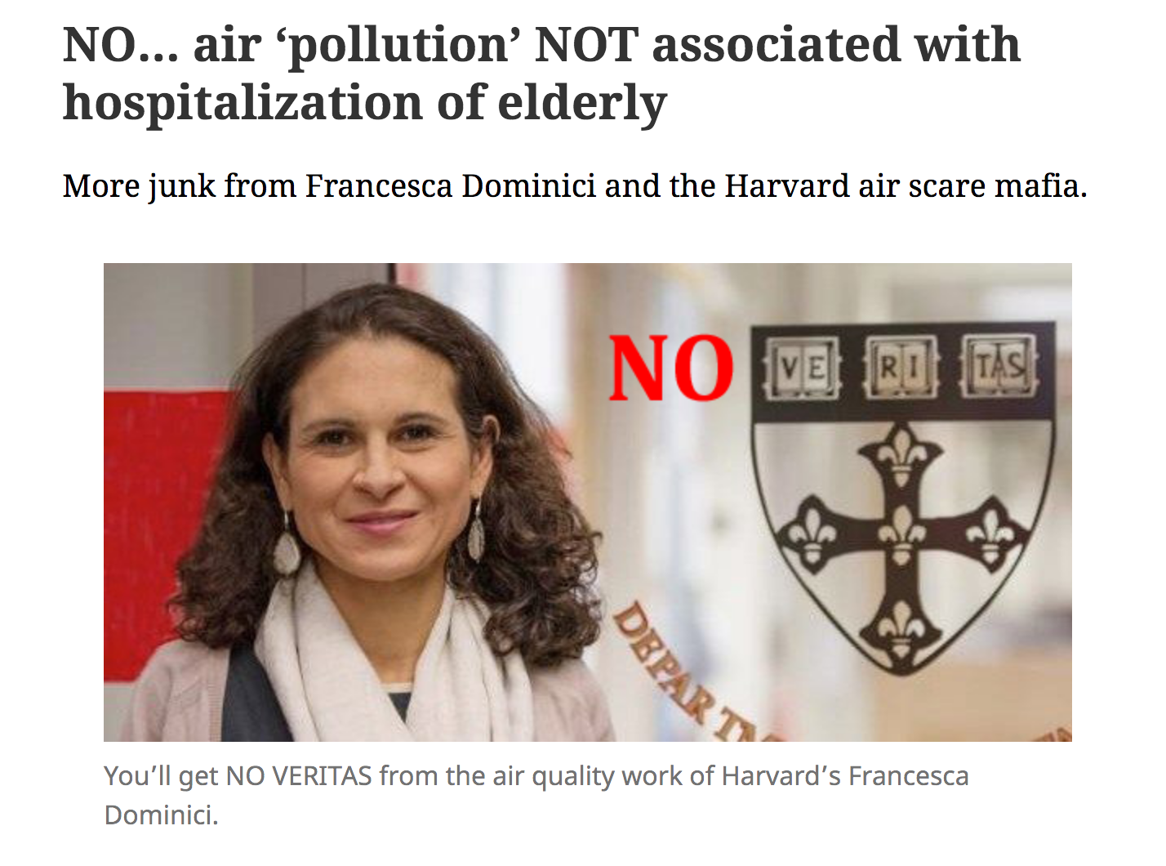
From the web site called junkscience.com by Steve Melloy
Notes:
Work on important problems: they are the ones that lead to methodological and transformative innovation
Aim high: use your talent for the social good, and remember now you can because there is data
Never compromise integrity and rigor: resist the anxiety of publishing at all cost
Embrace diversity: it will lead to better science and a better world
Empower your mentees: they learn by example
You can’t do it alone: family, friends and your pet matter

Slide 13


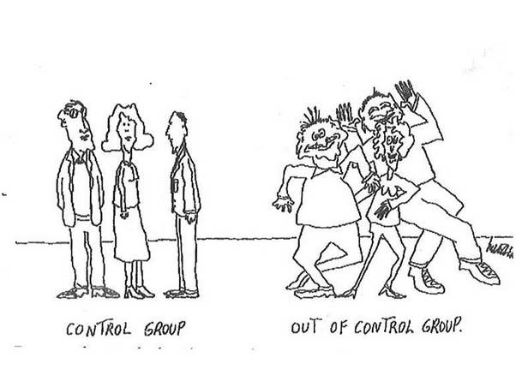
From Hypothesis first to Data First
From Randomization to Observation
Notes:
Data science: transitioning from a situation of testing an hypothesis and run a controlled experiment to data first

Slide 14
High Level Considerations in Causal inference
Design Trumps Analysis
Causality is mostly a story of successful design decisions, not statistical models or estimation
If we can randomize we have evidence of causality
If we cannot randomize, then we
Try to approximate the observational study as a randomized experiment
Define the counterfactuals
Estimate the un-observed counterfactual using well-defined control populations
Dominici, Zigler, Best practices for gauging evidence of causality in air pollution epidemiology, AJE 2017

Slide 15
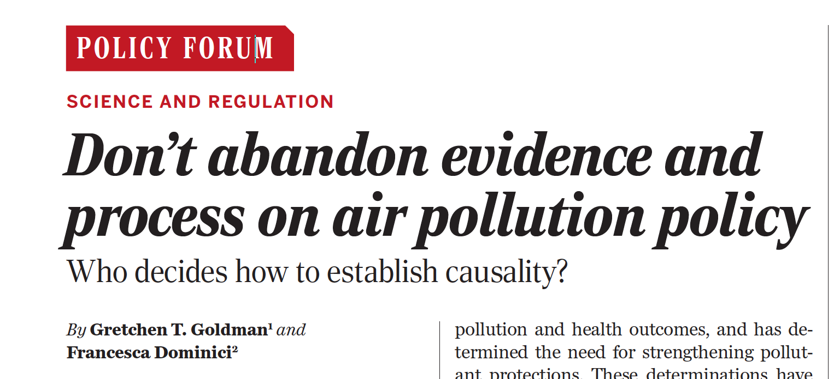
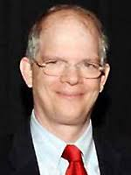
MANIPULATIVE CAUSATION: Under this framework, to justify regulatory action, air pollution epidemiological studies must demonstrate manipulative causation, that is, there must be direct evidence that the implementation of a regulatory action and/or a reduction in pollutant exposure leads to a health benefit
Chair of Clean Air Scientific Advisory Committee (CASAC) and former American Petroleum Institute consultant Tony Cox

Slide 16
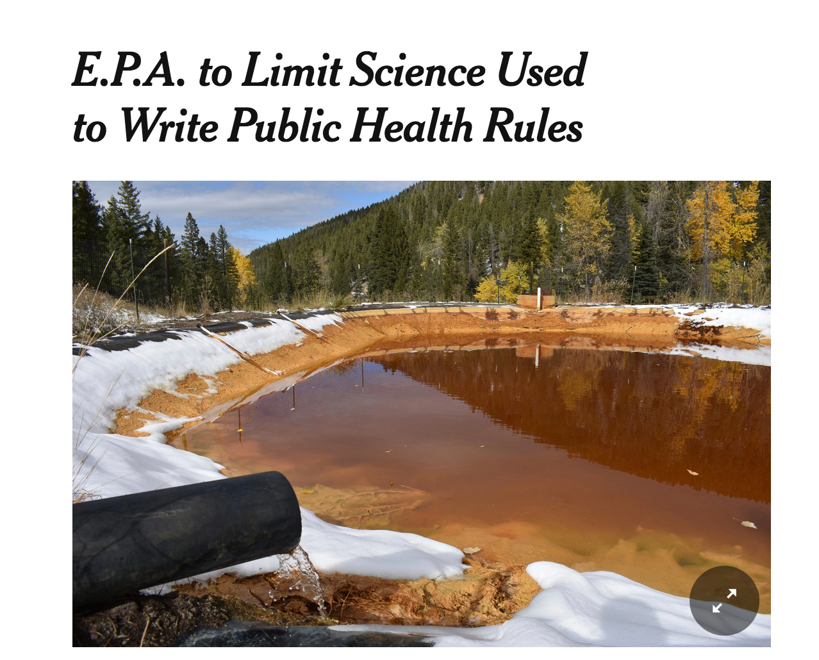

Slide 17
Reproducible workflows
Processing
Programs,
Code, and
Documentation
Analysis
Programs,
Code, and
Documentation
Tables
Collected Data
+
Documentation
Processed Data
+
Documentation
Figures
Results
Notes:
Reproducible workflows enable re-using code with new or updated inputs and make it easy to propogate error correction all the way down to tables, figures, and other final outputs.

Slide 18


The Team
Marianthi Kioumourtzoglou
Joel Schwartz
Joey Antonelli
Antonella Zanobetti
Iste Zahn
Corwin Zigler
Christine Choirat
Rachel Nethery
Qian Di
Kwonsang Lee
Qiao Wu
Georgia Papadogeorgou
Danielle Braun
Ben Sabath
Emma Thomas

Slide 19


Notes:
The Harvard Data Science Initiative (DSI) – leveraging Harvard University’s extraordinary intellectual ecosystem – unites leading computer scientists, statisticians, and domain experts from law, business, public policy, education, medicine, public health, and myriad academic disciplines to derive meaningful and actionable insights that will shape the world for generations to come. We build upon our bedrock of strength in computer science, statistics, and the liberal arts. In addition to data-driven research, we are fundamentally committed to data science education at all levels and across disciplines.

Slide 20
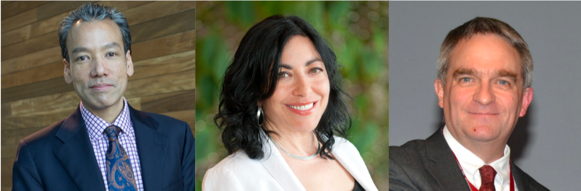
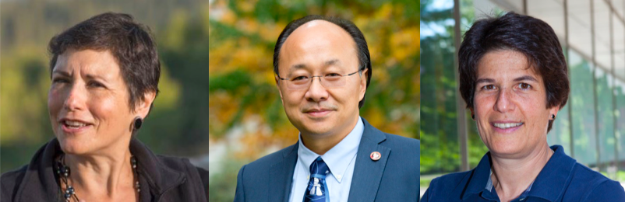
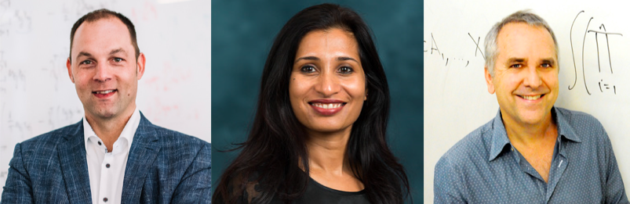
Rob Lue
Harvard University
Jennifer Chayes
Microsoft
John Eltinge
US Census Bureau
Erica Groshen
Cornell University
Xiao-li Meng
Harvard University
Margo Seltzer
University of British Columbia
A Microscopic, Telescopic, and Kaleidoscopic View of Data Science
Ralf Herbrich
Amazon
Bhramer Mukherjee
University of Michigan
Michael Jordan
UC Berkeley
Notes:
Harvard Data Science Review combines the features of a premier research journal, a leading educational publication, and a popular magazine. It publishes articles on fundamental data science research and education that intersect directly with societally important applications from industry, government, NGOs and more. The first issue will come out later this Spring, accompanied by ground-breaking data visualizations.

Slide 21


Tillie, 8 months old Labrador and special advisor to the Harvard Data Science Initiative

